Slide 1


CAPSTONE PROJECT
Walmart Sales Performance Analysis using Power BI
Presented By
Student Name: Tallam bavana
College Name: Manipal university Jaipur
Department: MBA (Data science and data analytics
Email ID: bavanaprasad19@gmail.com

Slide 2
OUTLINE:
Problem Statement
Proposed System/Solution
System Development Approach
Algorithm & Deployment
Result
Conclusion
Future Scope
References

Slide 3
Problem Statement:
Retail companies like Walmart generate large volumes of sales data daily across multiple branches, product lines, and customer segments.
However, without proper data analytics tools, it becomes difficult for management to monitor sales performance, identify profitable products, and understand customer purchasing behavior.
Walmart currently lacks a centralized analytical system that provides real-time insights into:
• Sales performance across cities and branches
• Product line profitability
• Customer purchase patterns
• Revenue trends over time
This lack of visibility makes strategic decision-making inefficient and limits the company’s ability to optimize operations and improve sales performance.

Slide 4
Proposed Solution:
To address this problem, a Power BI dashboard was developed to analyze Walmart sales data and provide actionable business insights.
The dashboard enables management to:
• Monitor overall sales performance
• Identify top-performing product categories
• Analyze customer purchasing behavior
• Evaluate branch performance
• Track revenue trends over time
Interactive filters and visualizations allow decision-makers to explore the data dynamically and make informed strategic decisions.

Slide 5
System Approach:
The project was developed using Microsoft Power BI for business intelligence and data visualization.
Technologies Used:
• Power BI Desktop – Dashboard creation
• Power Query – Data cleaning and transformation
• DAX (Data Analysis Expressions) – Calculated measures
• CSV Dataset – Walmart sales transaction data
Data Preparation Steps:
• Data loading and validation
• Data type correction
• Feature engineering (Month, Day, Time of Day)
• Creation of measures such as Total Revenue and Profit

Slide 6
Algorithm & Deployment:
Algorithm Selection:
Descriptive data analytics using Power BI and DAX functions (SUM, AVERAGE, COUNT) to analyze Walmart sales data and identify patterns in revenue, product performance, and customer behavior.
Data Input:
Historical Walmart sales dataset including branch, city, customer type, product line, quantity, total sales, date, payment method, and rating. Additional fields such as Time of Day, Day Name, and Month Name were derived.
Training Process:
Data was cleaned and transformed using Power Query. Calculated columns and measures were created using DAX to compute metrics like Total Revenue, Quantity Sold, Profit, and Average Rating.
Prediction Process:
Interactive Power BI dashboard analyzes sales trends, product performance, and customer insights using visualizations and filters.
Deployment
The dashboard is deployed in Power BI as an interactive reporting tool for data-driven business decision-making.

Slide 7
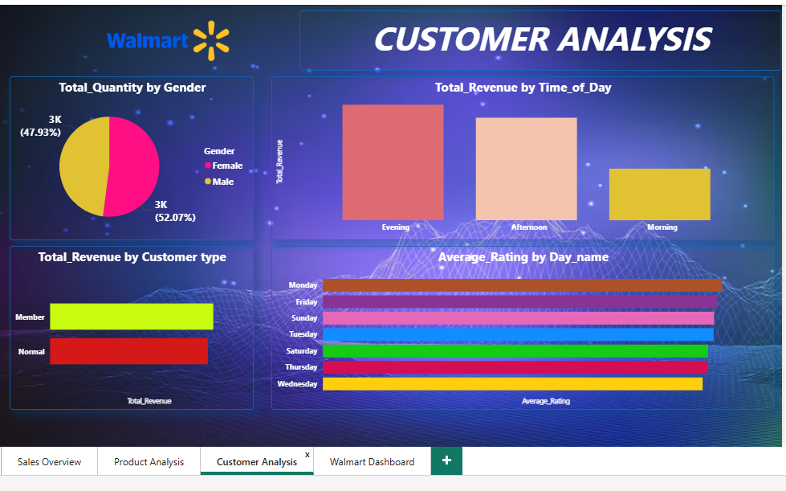
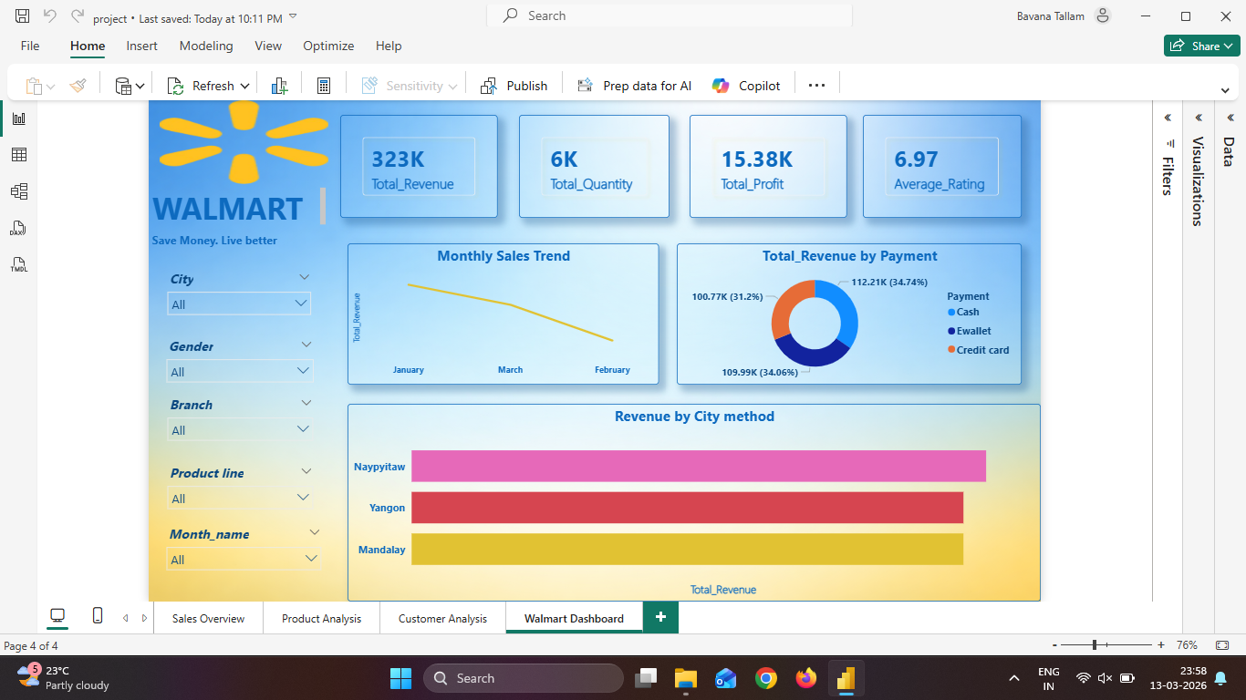
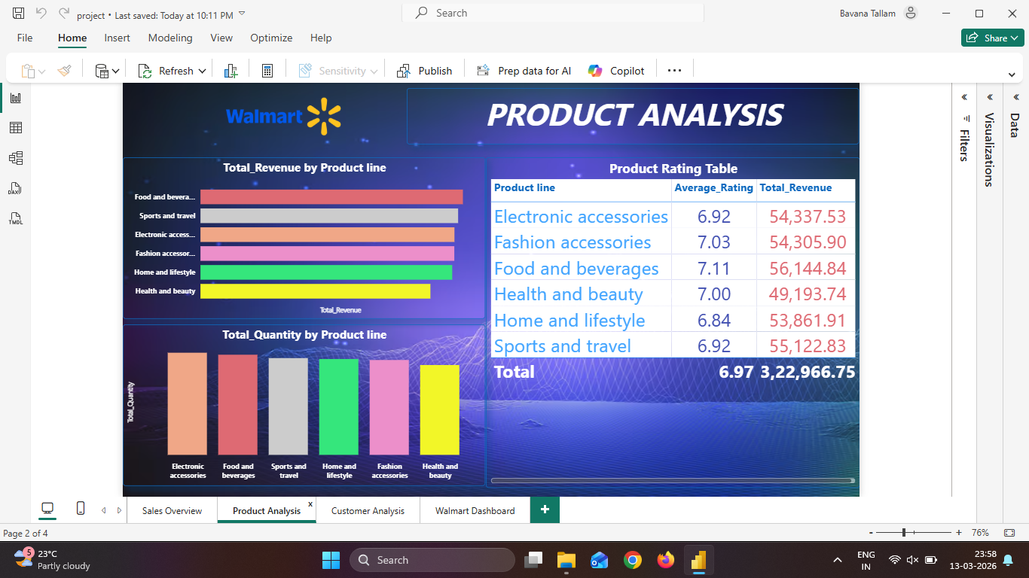
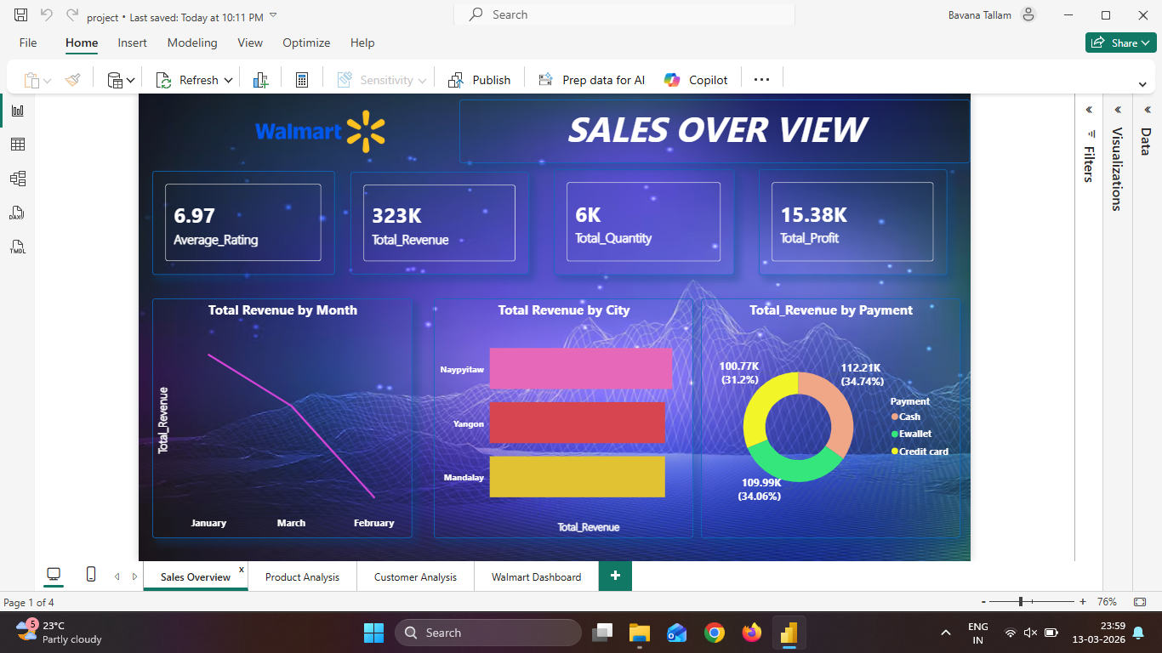
Result:

Slide 8
Conclusion:
The Power BI dashboard provides a centralized platform for analyzing Walmart sales data and identifying important business insights.
The dashboard enables management to:
• Monitor sales performance effectively
• Identify high-demand product categories
• Understand customer purchasing behavior
• Improve operational decision-making
By leveraging data visualization and analytics, Walmart can make more informed and strategic business decisions.

Slide 9
Future scope:
Future enhancements for this system may include:
• Integration with real-time sales data
• Predictive analytics for demand forecasting
• Advanced customer segmentation analysis
• Expansion of the dashboard to include inventory and supply chain analytics
• Deployment through Power BI Service for enterprise-level accessibility

Slide 10
References:
Walmart Sales Dataset – Kaggle
https://www.kaggle.com/c/walmart-recruiting-store-sales-forecasting
Microsoft Power BI Documentation
Data Analytics and Business Intelligence Best Practices

Slide 11
Thank You

